Slide 1
Hackathon Project

Slide 2
Brucella abortus
87 WGS
Reference
output
63 WGS
150 WGS

Slide 3
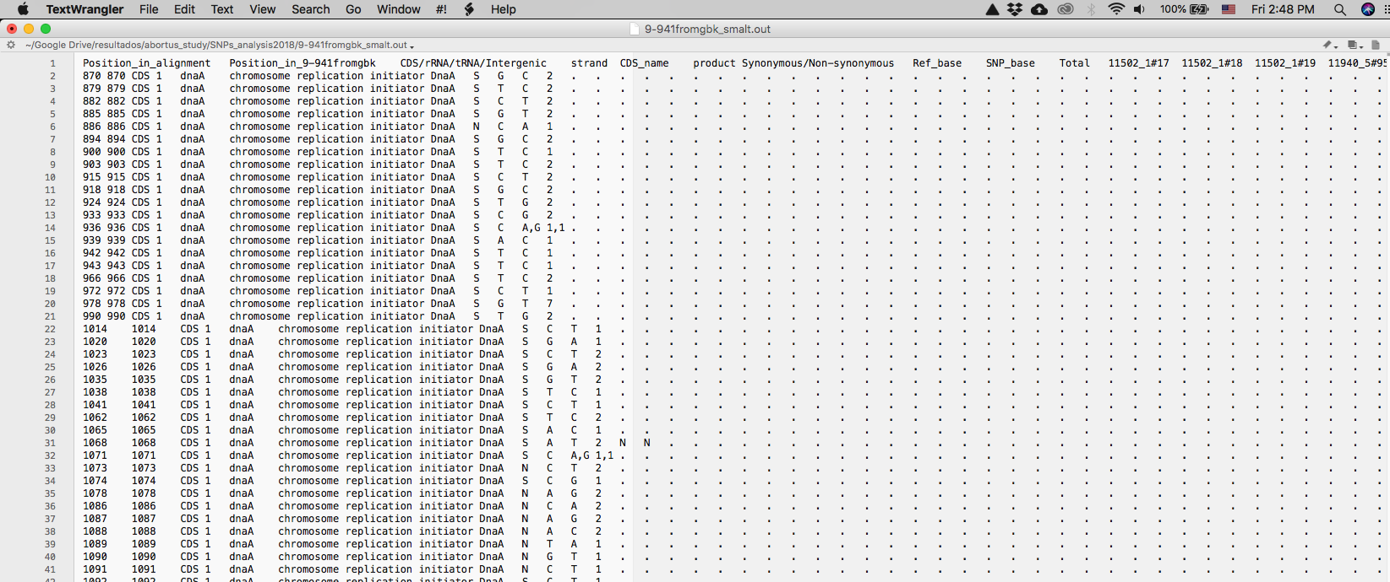
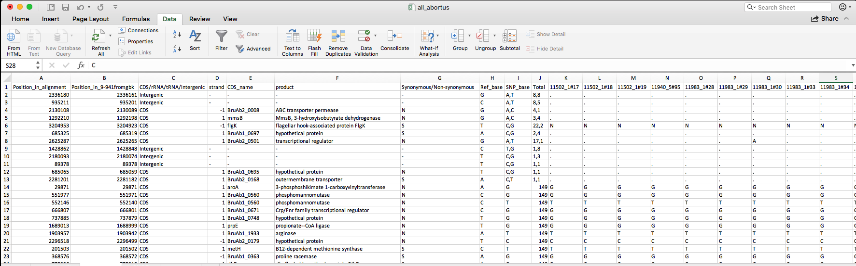
output
tab delimited

Slide 4
Information within the output file
Position in alignment
Position in the reference genome
Id of the position:
CDS/RNA/intergenic
Strand (forward-reverse)
Name/product
Synonymous/Non synonymous
Base in the reference and SNP
Total of genomes included in the alignment with the SNP per position
A column for each genome included in the alignment with the detail

Slide 5
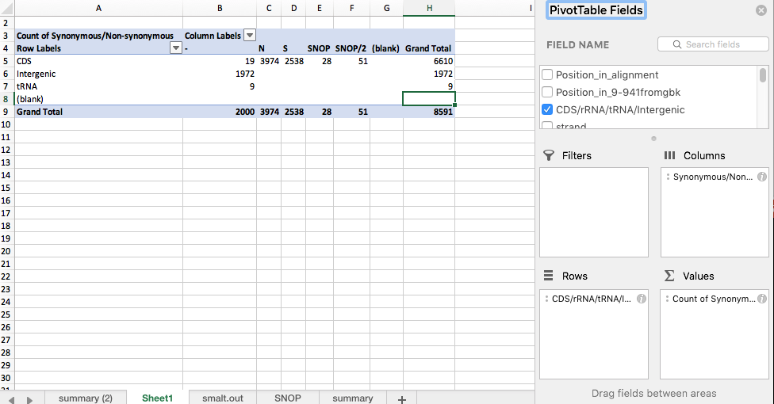
How to get the important information from the output?
Pivot tables…

Slide 6
dN/dS/SNOP
Detect more variant positions
Graphs
CDs
Position (coordinates)
Shared SNPs among genomes (columns)

Slide 7
Goals for the hackathon
A script(s) that return:
Information of SNPs shared by a subgroup of genomes within the analysis, and that are unique for that group.
Graphs for (i) SNPs density, (ii) non-synonymous SNPs density, (iii) synonymous SNPs density, and (iv) dN/dS along the alignment

